Slide 1

Breakfast Session Sponsored by AcademicCME
How Should the CE Industry Respond to a
Novel Healthcare Crisis?
Moderator:
Timothy Hayes, MD, PhD
President, AcademicCME

Slide 2






GOLD SPONSORS
SILVER SPONSORS

Slide 3

















BRONZE SPONSORS

Slide 4
How to Ask Questions
You can use the Peer Audience text line to send in a question 267-666-0CME (0263)
Tweet your question using the #CMEpalooza hashtag

Slide 5
Opinions, discussions and/or conclusions expressed are those of our panelists and do not represent an endorsement by, or a position of, their employer, its parent company, or affiliates.
Speaker Disclosure

Slide 6
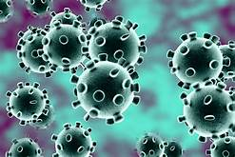
CME in Outbreaks and Pandemics: what do Frontline workers need to know ?
Laura hawryluck MSc. (Bioethics), MD FRCPC
Associate Professor Critical Care Medicine
University of Toronto, Canada

Slide 7

Objectives
Discuss what frontline healthcare workers need to know in rapid evolving outbreaks/pandemics of Emerging Pathogens
Discuss the challenges of Continuing Medical Education (CME) in such situations
Discuss potential ways to disseminate crucial CME/ tools that will help provision of patient care
Discuss potential partners in Continuing Medical Education (CME) activities

Slide 8
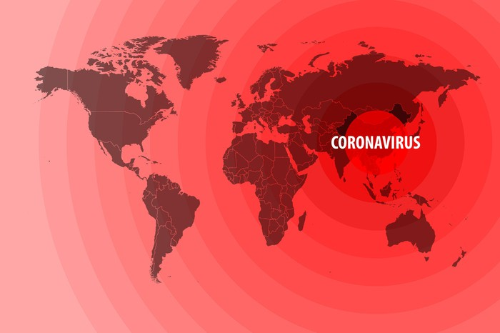
what do Frontline workers need to know ?
Emerging pathogen specific information
Personal Protective Equipment (PPE)
Surge planning Strategies and Process
Triage Planning and Process
Communication Strategies
Mental Health and Wellness of staff
Getty images

Slide 9
Emerging Pathogen
Specific Information
Key principle is to distinguish “news” from Scientific evidence
  Source of information ideally “from the field to the field” concept
  Need to clarify what we know / what we don’t/ what is being done to close this gap
Topics should include:
  course of illness: who gets sick/ timing/ course of illness/duration
  Modes of transmission/ Infection control precautions required
  Early warning signs of deterioration: what, if anything, is emerging?
  Markers of illness severity and prognosis
  Treatments: Supportive, Specific, Available Trials (Industry)
  Should there be limits placed on Treatment/ Withholding/ Withdrawal

Slide 10
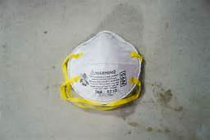
Personal Protective Equipment (PPE)
What PPE is required?
  level of precaution: contact, droplet, Airborne?
Staff education
  Don/ Doffing of PPE
  Handling of single use/ Multi-Use Equipment ( cleaning of contaminated surfaces)
  Knowledge of aerosol generating Medical Procedures (AGMP)
  Changes needed in PPE if AGMP
How do you plan for future?
  Communication of changes in PPE as new knowledge emerges/ Addressing Staff Distress
  Anticipated PPE supply needs/ working with Supply chains - anticipate needs
  Check List Planning Tools

Slide 11
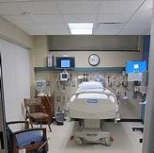
Surge Planning
How to develop a surge plan 101 for unexpected massive surges
  Environments/ Staff/ Equipment
  Re-deployment needs and methods
upskilling Inter-professional staff/ Education needs:
    Early warning signs ( in general and specific to emerging pathogens
    Principles of early resuscitation
    Critical Care basics ( vasopressors/ mechanical ventilation/ Care)
equipment purchasing/ supply chain issues
  How do you anticipate needs ( quick Business case)
  Costs– how do you negotiate? Compete?
  Getting input/Addressing multiple requests from staff
  Communication of Purchasing Decision-making
  INNOVATIONS IN PPE/ EQUIPMENT STERILIZATION/USE (INDUSTRY PARTNERSHIPS)

Slide 12
Maintaining Ongoing Non-Pandemic Patient care
How to develop plan to provide ongoing care for All patients
  Determining key programs and rationale for maintaining them
  Impact on core programs that might be needed for surge planning
  Staffing challenges: who if anyone gets re- deployed
  Impact of ongoing surge on maintaining Key program
  Communication to staff and public

Slide 13
Triage Planning
Education on Scientific and Ethical Models in triage planning
  Lessons from past experiences
  Specific modeling considerations Arising for specific pandemics
  Duty to care/ Staff Safety
Models of implementation
  Triage Officers/ Central triage committee formation and Education standards
  Appeals mechanisms
  Communication strategies to Healthcare workers/ Patients/ Families/ Public
  Review of application
legal liability issues

Slide 14
Communication
Education on Communication strategies
Education on responding to Media requests
  Pearls and pitfalls
Education on responsibilities re social media Posts and privacy Issues
  Legal issues
Communication to staff/ patients/ public
  How to develop effective strategy: what/ when/ how

Slide 15
Mental Health and Wellness
Development of multi-pronged approach to develop and provide programs targeting staff wellness/coping
  Development of survey tools to understand the program and ask staff Perceived needs
  Development of Education/ Wellness programs to help support staff
    Industry partnerships /use of existing tools/programs
    Development of programs specifically targeting needs (Industry partnership)
    Distress phone lines ( Staff re-deployment/training Resources – Industry Partners)
    Meditation/wellness forums/ online programs

Slide 16
CME Delivery
Short and Effective
Multi-modal in nature: online, webinar, podcast formats that can be repeated at different times/ listened to even on way to work
Download-able tools/toolkits that are practical and can be used by multiple organizations
up to date/ Reflecting changing knowledge: methods to correct previously delivered information as it changes
Innovations that will help meet patient care and family needs

Slide 17
Conclusions
Continuing Medical education plays a crucial role in Pandemics/outbreaks of Emerging pathogens
Challenge is to be accurate, flexible in delivery and meet needs of physicians and healthcare teams on frontline: Right Time/ Right Content/ Right format
Key component is to include education on planning initiatives undertaken by hospital administrators

Slide 18
Please click on the survey link at the top of the LIVE tab to help us get a sense of who is watching CMEpalooza Spring. It’s only 7 questions.
A Survey? I Love Surveys!

Slide 19
Learners viewing this session live via the CMEpalooza Spring website will need to refresh their browser. The next session will be up momentarily.
To View the Next Session

