Slide 1

Shiny Outcomes People
Session Sponsored by PeerAudience
Moderator:
Jason Olivieri
Director of Outcomes, Med-IQ CE

Slide 2






GOLD SPONSORS
SILVER SPONSORS

Slide 3

















BRONZE SPONSORS

Slide 4
How to Ask Questions
You can use the Peer Audience text line to send in a question 267-666-0CME (0263)
Tweet your question using the #CMEpalooza hashtag

Slide 5
Opinions, discussions and/or conclusions expressed are those of our panelists and do not represent an endorsement by, or a position of, their employer, its parent company, or affiliates.
Speaker Disclosure

Slide 6
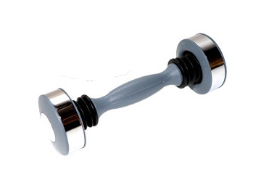
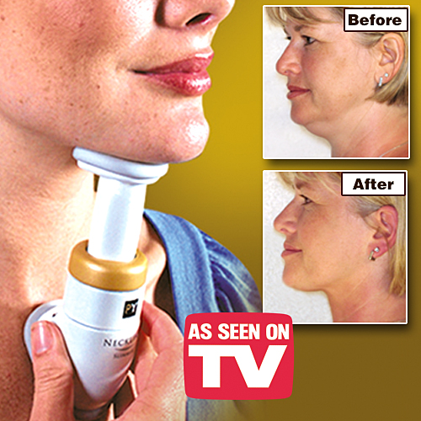
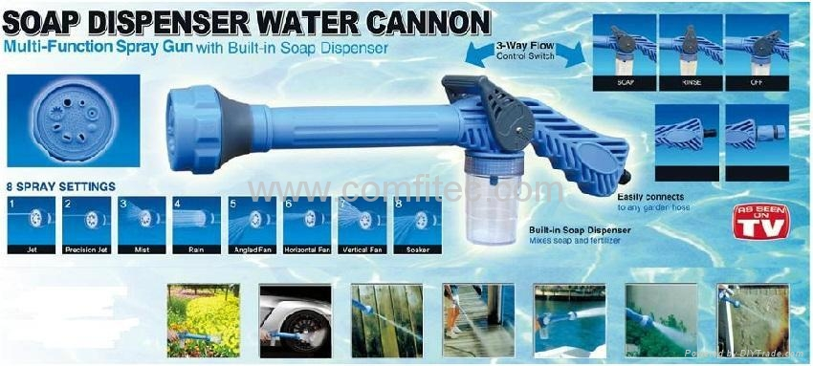








Slide 7

Greetings from Gatlinburg!

Slide 8


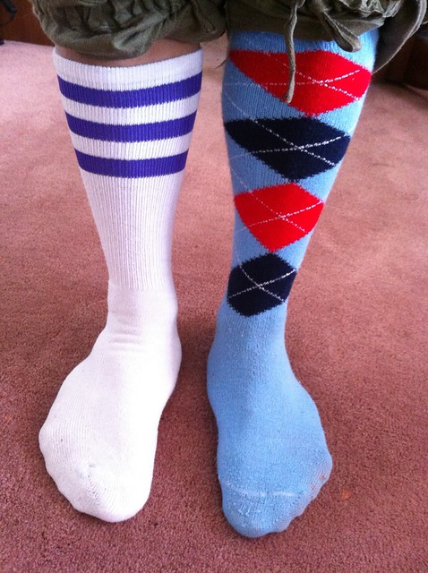

Hot Topics!
Effect or Affect?
To NBME or not NBME?
Do the dollars make sense?
DOES Matching Matter?

Slide 9




Shiny Outcomes People!
Derek Dietze, MA, FACEhp, CHCP
President
Metrics for Learning, LLC
Katie Lucero, MS, PhD
Director, Outcomes and Insights
Medscape, LLC
Anthony Gage, MS
Director, Outcomes Strategy and Analytics
Practicing Clinicians Exchange
Jason Olivieri, MPH
Director, Educational Outcomes
Med-IQ

Slide 10
To NBME or not NBME?

Slide 11

The Goal
We are constructing a ruler!
The goal of educational measurement is to construct a ruler that helps us place people on an ability continuum (we give them a score).
We interpret these scores as though they tell us something about how individuals learned, or how programs performed overall.

Slide 12

Common Flaws
Long and complicated options
Vague options open to interpretation
Numeric data not presented in order
None of the Above or All of the Above
Unnecessary complication (window dressing)
Negatively phrased stems or options
Grammatical cues
Use of absolute terms (i.e., “always” or “never”)
Correct option stands out for non-content reasons

Slide 13


Slide 14

Each Item Should:
Focus on one important concept at a time.
Assess application of knowledge, not recall of facts.*
Be focused, closed, clear.
All options should be homogenous and plausible.
Be reviewed by independent expert.
* Sometimes education is designed specifically for awareness or knowledge. If that is the case, this rule does not apply.

Slide 15

Why is this Important for My Outcomes?
Psychometrically Speaking
Reliability
  More consistent measurement over time
  Less measurement error
Validity
  More certainty that the scores you report and discuss regarding your education actually measure the gaps and learning objectives stemming from the need assessment
Practically Speaking
More precise measurement (lower amounts of error)
Better ability to statistically detect differences between groups that truly exist in the population
If you are using predictive models, reliability in measurement of predictors and criterion has a major impact on results of the model.
More accurate feedback to learners

Slide 16
DOES Matching Matter?

Slide 17


Everything is Better in Pairs!
Double mint?
Double trouble?

Slide 18


What is aggregate?
Summary statistics from many observations
% Correct
%
%
Pre
Post
“Aggregate” in CME industry really means using ALL RESPONSES to report summary statistics

Slide 19


What is all responses?
What is paired?
pre/post
pre/post
pre/post
pre
post
Missing data
Complete data

Slide 20

The Argument for Paired
Greater statistical precision and reduced measurement error (paired samples t-test or McNemar’s instead of independent samples or chi-square)
By Question
Overall
More aggregate statistics available to describe the data
% Correct
pre
post
%
Improved
✗
✓
answers at least one more question correctly at post
%
Reinforced
✓
✓
answers the same number of questions correctly pre/post
Pre
Post
answers no questions correctly at post or fewer than at pre
✗
✗
Need Education
✓
Known sample bias (those who are more likely to complete all questions)

Slide 21
Proof is in the Pudding
% responses correct pre/post
% who answered at least one more question correctly
23% improved their knowledge and competence
Potentially a better story with paired statistics

Slide 22
Effect or Affect?

Slide 23


I quantify the effect across all your outcome questions into a single metric
You can use this number to compare the effectiveness across activities, formats, or topic areas…even published literature!
I sound technical, but am super-easy to calculate
Effect Size

Slide 24
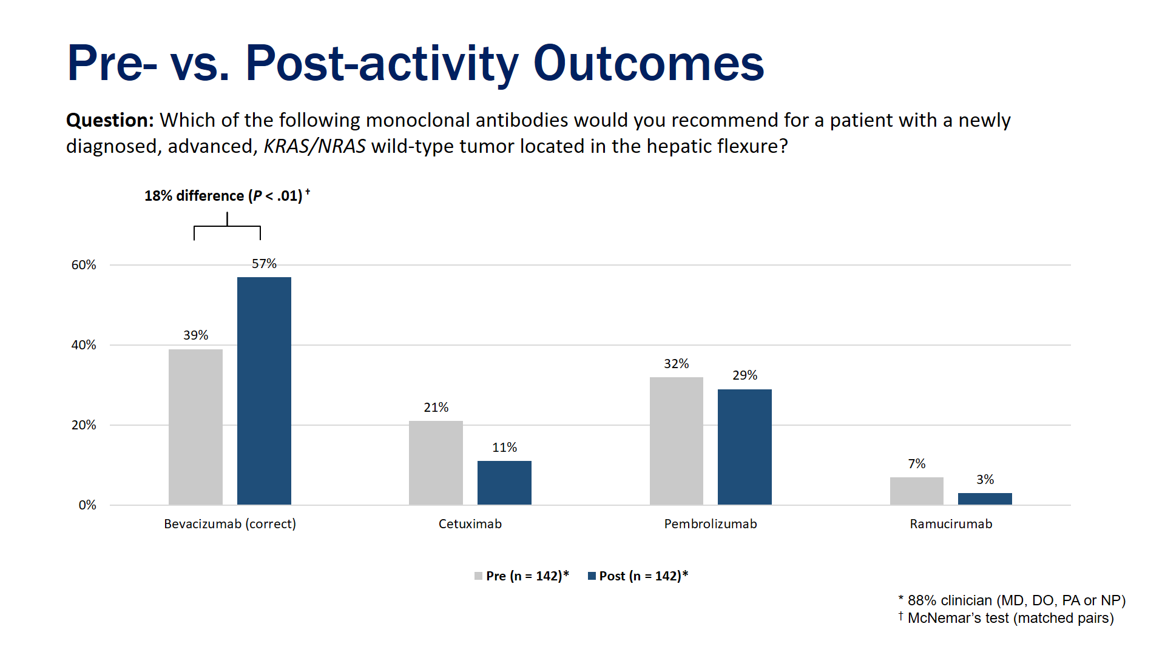

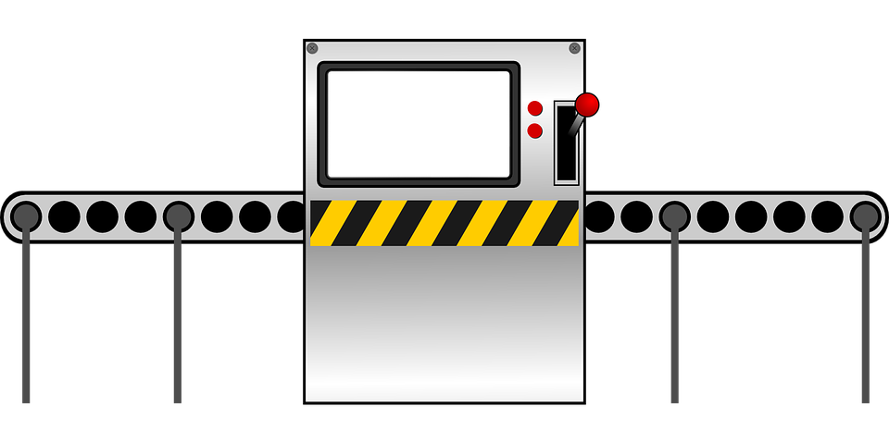



Mean
μ σ
d
d
Standard deviation
effectometer2000
d =
.83
CME works!

Slide 25
Educational effect: single activity
1.0
Standardized measure of the magnitude of educational effect (Cohen’s d)¹
Permits comparisons of effect across similar educational activities (ie, benchmarking)
Typical range between 0 (no effect) and 0.8 (large effect)²
Compared to Internet-based CME over previous three years (inclusive of 65 activities), expected range = .46 - .74
Data indicates this activity exceeded benchmark and was above expected range for Internet-based CME
Internet-based CME, pre vs. post, Cohen’s d = .83
Large effect²
Expected range: .46 - .74
Small effect²
Olivieri J, Harris D, Dietze D, Viercek C. A Call for Calculating Effect Size in CME Outcome Measurement. CE Measure 2012;6:22-25.
Cohen J. (1988) Statistical power analysis for behavioral sciences (2nd ed). Hillsdale, NJ: Lawrence Earbaum Associates.
0

Slide 26
Educational effect: program-level
Cook et al³
Cohen J.¹
Mansouri & Lockyear¹
Cohen J. (1988) Statistical power analysis for behavioral sciences (2nd ed). Hillsdale, NJ: Lawrence Earbaum Associates.
Mansouri M, Lockyear J. A meta-analysis of continuing medical education effectiveness. JCEHP 2007;27;6-15.
Cook DA, et al. Internet-based learning in the health professions: A meta-analysis. JAMA 2008;300:1181-1196.

Slide 27

Sure, there are a few concerns:
Quality of assessments – not all questions are create equal!
Number of assessments – how many questions is enough?
Response – did a representative sample of participants respond?
Study design – is pre/post equivalent to post/control?
Benchmarks – Heterogeneity and publication bias in peer review literature?

Slide 28
Do the dollars make sense?
Direct Health Care System Costs and Cost Savings

Slide 29
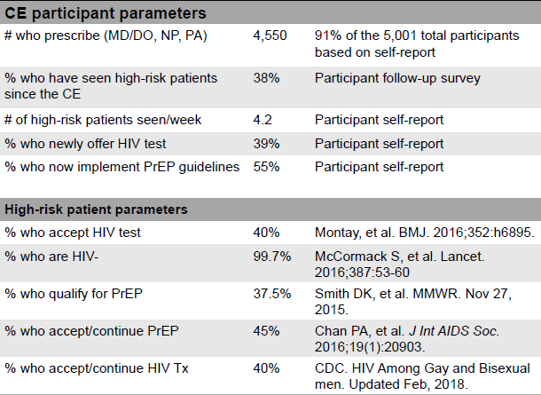
Example 1: CE on Increased HIV Testing and Use of PrEP Guidelines* -- Direct Costs
As a result of the education:
How many patients are…
…offered HIV test?
…identified as HIV+ or –?
…treated for HIV?
…treated using PrEP?
What are direct care costs over 1 year for newly-treated…
…HIV+ patients?
…patients on PrEP?
35-
30-
*by Vindico Medical Education with an educational grant from Gilead Sciences Medical Affairs

Slide 30



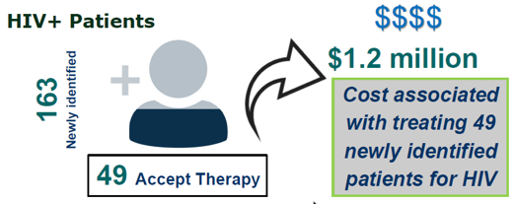

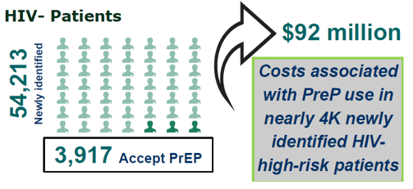
Adapted from: Robinson K, Dietze D, Esgro R, Elion R, Continuing Education Improves HIC Screening and Use of PrEP in High-Risk Patients, Poster #1320, ID Week 2018.

Slide 31
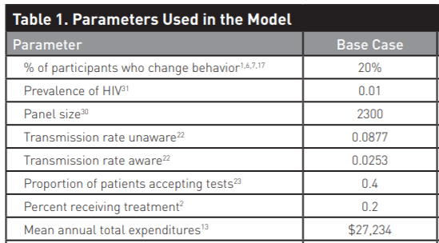
Example 2: CE on Increased Early HIV Testing and Treatment of HIV* -- Cost Savings
Designed to promote earlier testing and treatment, which could in turn lead to reduced transmission, fewer new cases, lower costs.
Earlier treatment can also decrease costs because delaying care is associated with rapidly escalating healthcare utilization.
N=3,432 primary care providers
Model Results Estimates (Annually):
394 HIV cases prevented
Mean direct cost savings of $10.7 M
*Ravyn D, Kummerle D, Hujdich B. Educational and Economic Outcomes of an Intervention to Improve Early Testing and Treatment of HIV. CE Measure 2015;9:20-25. Educational grant from Bristol Myers Squibb.

Slide 32

Questions?

Slide 33
Please click on the survey link at the top of the LIVE tab to help us get a sense of who is watching CMEpalooza Spring. It’s only 7 questions.
A Survey? I Love Surveys!

Slide 34
Learners viewing this session live via the CMEpalooza Spring website will need to refresh their browser. The next session will be up momentarily.
To View the Next Session

